Slide 1
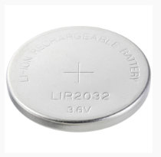
Energy Storage
➢ Candidate storage devices
Supercapacitors and rechargeable button-cell battery
Device
Capacity
Max./Nominal Voltage
Key Property
NEXT 104Z5.5V11.5X8.5F
0.1 F
5.5 VDC
ESR < 16 Ω
Leakage 0.14 mA
BZ015B603ZSB
0.06 F
5.5 VDC
ESR 80 mΩ
Leakage 10 µA
VOLTCRAFT LIR2032
45 mAh
3.6 V
Rechargeable lithium
< 400 cycles
NEXT 1.51 J | BZ015 0.91 J | LIR2032 583.2 J
Estimated nominal stored energy
LIR2032: ≈ 583 J
Battery energy uses capacity × nominal voltage; supercapacitor energy uses ½CV².
VOLTCRAFT LIR2032
Selected storage device: LIR2032

